Slide 1
Dynamic Persistence
Doug Clarke

Slide 2
Background
What is Dynamic Persistence?
When would someone use Dynamic Persistence?

Slide 3
Parties Involved
Requirements
  Doug Clarke
Core & DBWS/XR
  Mike Norman
MOXy
  Rick Barkhouse
SDO
  Blaise Doughan

Slide 4
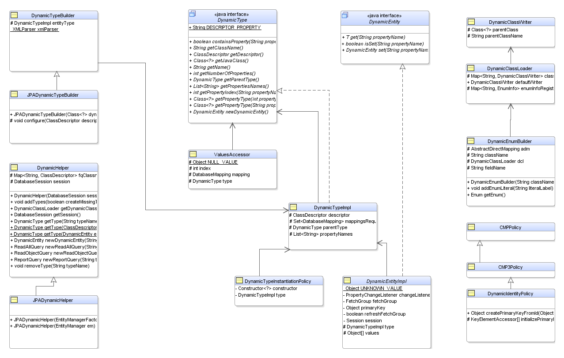
Design

Slide 5
Application API
Standard API Usage
  JPA
  MOXy

Slide 6
Defining Types
JPA and Native ORM
  API
    DynamicTypeBuilder
    JPADynamicTypeBuilder
  XML
    eclipselink-orm.xml
    Native deployment XML

Slide 7
The Magic

Slide 8
Creating the Classes
DynamicClassLoader – custom class loader
DynamicClassWriter using ASM
Now wired into JPA metadata processing

Slide 9
Dynamic Persistence in MOXy
InputStream inputStream = new FileInputStream("customer.xsd");
DynamicJAXBContext dContext =
DynamicJAXBContextFactory.createContextFromXSD(inputStream, null, null, null);
inputStream.close();
More Info and Examples:
http://wiki.eclipse.org/EclipseLink/Development/2.1/DynamicMOXy/296967/Documentation

Slide 10
Examples/Demos
SimpleMap
Employee
  API
  eclispelink-orm.xml
MOXy

Slide 11
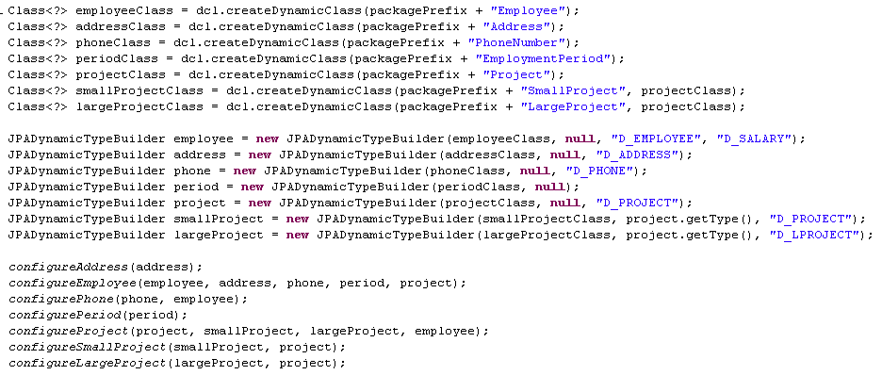
Dynamic Employee JPA Example using API

Slide 12
Future
JPA
  Additional mappings as required by users
MOXy
  eclispelink-oxm.xml support

